Slide 1
Vocabulary!
PowerPoint Presentation
Due by Email:
icflamm@sof.philasd.org
3. 10 words from Vocab Tab
Of Unit 2 OneNote
4. Follow Directions for credit
Two slides are Due Today . . .

Slide 2
All 11 slides are due Wednesday,
12-7-11
Make sure you follow the directions

Slide 3
You need 2 slides completed today:
1 title slide with your name
1 vocabulary word slide, for “aspire””
Keep reading . . .

Slide 4
Slides must contain:
1. Word and definition
2. A sentence showing the meaning of the
word, relating to the image.
3. An image that illustrates your sentence
(you may want to choose images first).

Slide 5
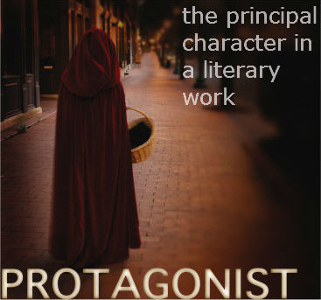
Lets look at some of Mr. Flamm’s examples:
Example One:
The protagonist of “Little Red Riding Hood” takes a
deserted route to her grandmother’s house.

Slide 6
Example One:
Definition
Image
Word
Sentence
Notice how the sentence relates to the actual image,
AND shows that you know how to use the vocabulary word.
The protagonist of “Little Red Riding Hood” takes a
deserted route to her grandmother’s house.

Slide 7
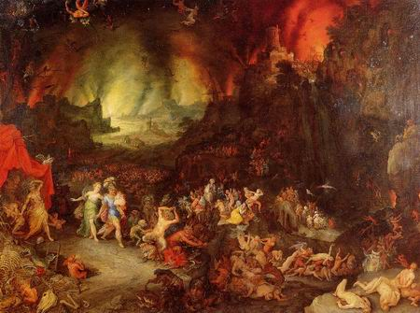
Example Two:
Underworld
a world beneath or below the normal world
Sure the underworld is crowded, but at least it’s not as boring as that other place.

Slide 8
Example Two:
Underworld
Word
Image
Definition
Sentence
a world beneath or below the normal world
Notice how the sentence relates to the actual image,
AND shows that you know how to use the vocabulary word.
Sure the underworld is crowded, but at least it’s not as boring as that other place.

Slide 9
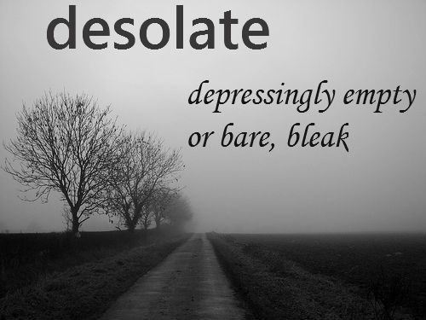
Example Three:
The desolate landscape had a sense of loneliness about it.

Slide 10
Example Three:
Word
Definition
Image
Sentence
Notice how the sentence relates to the actual image,
AND shows that you know how to use the vocabulary word.
The desolate landscape had a sense of loneliness about it.

Slide 11
Now,
Complete the
following two
Slides:

Slide 12
Unit 2 Vocabulary
This will be your title slide –
you can change its look if you want to.
Oh . . . Delete this blue box!
Your Name Here
Your Partner’s Name Here

Slide 13
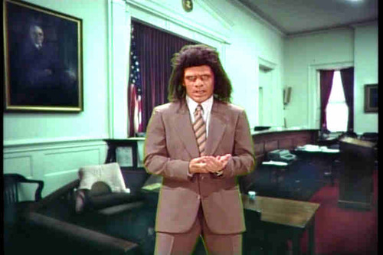
Aspire
to strive for a goal;
to want or desire something excellent or far beyond the current state
I copied the definition and sentence from my OneNote file
Oh . . . Delete this blue box!
Delete this text, and paste your sentence for “aspire” here.
Then, replace the caveman image above with one that matches your sentence (unless you aspire to be a caveman lawyer).

Slide 14
Now,
Delete slides
1 through 11
Of this very
Presentation,
and email it to:
icflamm@sof.philasd.org

Slide 15
Remember to
Complete nine
More slides based
On your choice of
Words from the
Unit 2 OneNote
By Wednesday!

